Slide 1
Managing Accounts Payables
RTR AP Managing Accounts Payables

Slide 2

Prerequisites and Ground Rules
Ground Rules
  Single conversation
  Please “Raise Hand” in Teams
Prerequisites
  SAP Overview & Navigation
Roles
  Employee
  Accounts Payable Accountant
Duration of Class
  3 hrs
Class Attendance
  Attendance log

Slide 3
Welcome to Virtual Training!
Classroom Logistics
  Computer and User IDs
  Course schedule: duration
  Attendance Tracking
  Parking Lot
Check: Participants have copies of all materials
Link to electronic versions of Work Instructions, Job Aids, and SIMs at SuccessFactors

Slide 4

Course Objectives
You should be able to:
Describe the accounts payable process
Enter/park a vendor invoice
Enter a vendor credit memo
Create a vendor account
Initiate the automatic clearing process

Slide 5
Agenda
Unit 1 – Introduction – Accounts Payable (20 mins)
Unit 2 – Enter/Park a Vendor Invoice (60 mins)
Unit 3 – Enter a Vendor Credit Memo (60 mins)
Unit 4 - Create a Vendor Account (30 mins)
Unit 5 – Summary (10 mins)

Slide 6
1
You should be able to:
Describe the accounts payable process
Define new SAP terms for accounts payable

Slide 7
What is Accounts Payable (AP)?
AP is a critical business process through which FAI manages its payable obligations effectively
Vital for FAI because:
  It takes charge of paying bills on a timely basis
  Vendors ensure an uninterrupted flow of supplies and services due to on-time payments
  It ensures there are no overdue charges, penalties, or late fees
  It ensures all invoices due are tracked and paid properly

Slide 8
Accounts Payable in SAP
Accounts Payable is a submodule of SAP FI used to manage and record Accounting data for all vendors
It handles vendor invoices, approvals, payments and other allied activities
Any postings made in Accounts Payable are updated in General Ledger as well
AP’s role is to complete payments, plus processing, verifying and reconciling invoices

Slide 9
Accounts Payable Process Flow
Invoice Receipt/ Verification
Release Payment
Reconciliation
Make Payment
Reporting
The Accounts Payable Life Cycle:
  Invoice is received and a 2 or 3-way match is performed
  Payment is released upon approval
  Payment is made to vendor via either ACH deposit or paper check
  Review of all accounts at period end is done to ensure accounts are balanced
  Generate AP reports as needed

Slide 10

What’s In It For Me?
The Bad:
Potential process changes to accommodate navigation in a new environment
Needing to invest time to learn a new system
The Good:
Ensures a streamlined invoice matching and approval process
Helps to ensure the AP lifecycle is managed in a centralized location with on time results and minimal manual intervention
  For FAI:
Decrease department costs through automated postings, self-service tools, and mobile access for key payables information
I’ll just trike-out

Slide 11
New Terms
New Term | Definition
Accounts Payable | A short-term debt that a company accrues when they purchase a good and/or service
Accruals | Recording of expenses incurred in a period for which no invoice or payment has changed hands by the end of that period. Accruals enable company’s to be more accurate on their cash flow forecasts
Credit Memo | A document issued by a vendor to a buyer that offsets a specified amount from an invoice, which makes good issues such as damaged/returned goods, lack of delivery, incorrect pricing, freight charges etc.. Vendors usually apply credit memo amount to a customers outstanding balances or issues the customer a refund
Debit Balance | Represents an asset or expense for a company; in a general ledger account, represents a vendor’s debt owed to a company, which can occur as a result of returns, rebates allowances and chargebacks
Invoice Matching | The process in which information on a supplier’s invoice is compared with relevant documents, such as a service contract, purchase order or goods receipt. The process of matching, approving and reconciling invoices may be time-consuming, leading to delays in settling payments

Slide 12

Unit 1, # 1
What is the role of AP?

Slide 13
Unit 1, # 1
What is the role of AP?
  AP’s role is to complete payments, plus processing, verifying and reconciling invoices

Slide 14

Summary – Unit
You should now be able to:
Describe the accounts payable process
Define new SAP terms for accounts payable

Slide 16
Agenda
Unit 1 – Introduction – Accounts Payable (20 mins)
Unit 2 – Enter/Park a Vendor Invoice (60 mins)
Unit 3 – Enter a Vendor Credit Memo (60 mins)
Unit 4 - Create a Vendor Account (30 mins)
Unit 5 – Summary (10 mins)

Slide 17
2
You should be able to:
Enter a credit memo
Initiate the automatic clearing process
Initiate a post with clearing

Slide 18
Entering a Vendor Credit Memo
Credit memos can be applied to a vendor’s account as a payment or reduction in cost
Credit memo must be entered manually in the system
Reasons for a credit memo include:
  Refund for damaged goods
  Return of goods/Canceled services
Invoice Receipt/ Verification
Release Payment
Reconciliation
Make Payment
Reporting

Slide 19
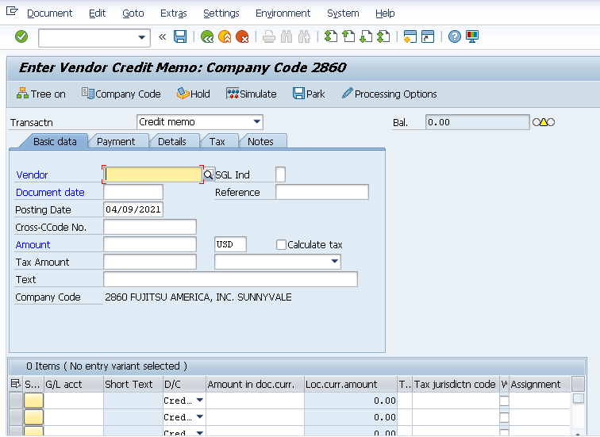
Enter Credit Memo
Some fields required prior to entering a credit memo include:
  Vendor
  Document Date
  Amount

Slide 20
Enter a Credit Memo – Process Flowchart
Enter a Credit Memo
AP Manager
Credit Memo reviewed by Manager before entry
Decision
Data Entry Team
Review BPP – Create Credit Memo
Create Credit Memo in SAP
FB65
Original invoice ref # required
G/L posting will be expense credit and vendor debit
End
Activity Outside of OneERP
Name Only
Output

Slide 21

Demo 2.1: Enter a Credit Memo
A credit memo for Global Resources has been issued for canceled services. The memo must be entered in the system
Notes
  Transaction Code: FB65
Notes:
Demonstration using:
Field: value
Field: value
Action
Other steps

Slide 22

Exercise 2.2: Enter a Credit Memo
A credit memo for Global Resources has been issued for canceled services. The memo must be entered in the system
Enter a Credit Memo
Notes
  Transaction Code: FB65
Notes:
Data Fields:
Field: value
Field: value

Slide 23
Clear a Vendor Account
After a credit memo is posted to a vendor’s account, it must be cleared
If not cleared, debits or credits remain on the vendor’s account as open items
Deducted from vendor’s next payment
Invoice Receipt/ Verification
Release Payment
Reconciliation
Make Payment
Reporting

Slide 24
Demo 2.3: Clear a Vendor Account
A credit memo has been posted to Global Resources account and now the account must be cleared
Notes
  Transaction Code: FB65
Notes:
Demonstration using:
Field: value
Field: value
Action
Other steps

Slide 25
Exercise 2.4: Clear a Vendor Account
A credit memo has been posted to Global Resources account and now the account must be cleared
Clear a customer account
Notes
  Transaction Code: FB65
Notes:
Data Fields:
Field: value
Field: value

Slide 26
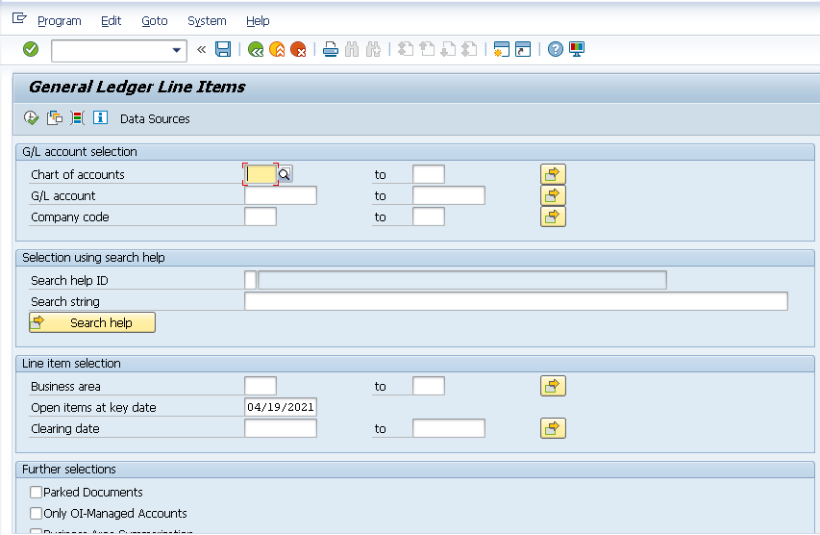
Post with Clearing
Use the post with clearing function (F-51) to enter document line items and select open items to be cleared
Once all prerequisites for clearing are fulfilled, the system clears the open items
Invoice Receipt/ Verification
Release Payment
Reconciliation
Make Payment
Reporting

Slide 27
Demo 2.5: Initiate a Posting with Clearing
A series of vendors must have their accounts cleared. Enter all open postings to be cleared using the General Ledger Line Items transaction
Notes
  Transaction Code: F-51
Notes:
Demonstration using:
Field: value
Field: value
Action
Other steps

Slide 28
Exercise 2.5: Initiate a Posting with Clearing
A series of vendors must have their accounts cleared. Enter all open postings to be cleared using the General Ledger Line Items transaction
Clear a vendor account
Notes
  Transaction Code: F-51
Notes:
Data Fields:
Field: value
Field: value

Slide 29
Future Payment/Invoice Upload Options
The following payment and invoice upload options are scheduled to be available for use in the system:
  P/E Card:
    US bank card for non-catalog procurement
  PAYPLUS:
    Process used by FAI to pay vendors through US Bank
  TANGOE:
    Uploads invoice file to server TANGOERM then advises AP by forwarding .csv files

Slide 30
Future Payment/Invoice Upload Options (Cont.)
The following payment and invoice upload options are scheduled to be available for use in the system:
  ZFBOA:
    ACH and check interface with Bank of America to transfer required payments
  ZFRBC:
    ACH interface with Royal Bank to transfer required payments

Slide 31
Unit 2, # 1
Reasons for a credit memo include?

Slide 32
Unit 2, # 1
Reasons for a credit memo include?
  Reasons for a credit memo include:
    Refund for damaged goods
    Return of goods/Canceled services

Slide 33
2
You should now be able to:
Enter a credit memo
Initiate the automatic clearing process
Initiate a post with clearing

Slide 34

Time for a Break!
Class starts again in 10 minutes

Slide 36
Agenda
Unit 1 – Introduction – Accounts Payable (20 mins)
Unit 2 – Enter/Park a Vendor Invoice (60 mins)
Unit 3 – Enter a Vendor Credit Memo (60 mins)
Unit 4 - Create a Vendor Account (30 mins)
Unit 5 – Summary (10 mins)

Slide 37
3
You should be able to:
Enter a vendor invoice
Initiate an automatic payment transaction
Enter a non-purchase order invoice
Perform the steps needed to park a vendor invoice

Slide 38
Entering Invoice Data
Use this procedure during invoice verification to record data that is relevant for interest on arrears, such as date of invoice receipt and suspension days
Invoice receipt and entry depends on the vendor and includes:
  Receiving an Excel file for upload
  Receiving an invoice via email
  Vendor interfaces
Invoice Receipt/ Verification
Release Payment
Reconciliation
Make Payment
Reporting

Slide 39
Invoice Entry (2-Way Match) Process Flow
Invoice Entry (2-Way Match)
AP Data Entry
Review BPP - Invoice Matching Process (PO Based)
Enter Invoice in SAP
MIRO
Review Vertex Tax Calculation against invoice
G/L posting will be expense debit and vendor credit
Invoice is Blocked from Payment
Approval notification sent to Requester
of PO
PO Requester
Approved?
Create SE in Procurement
ML81N
Yes
End
NO
AP SME
Follow up with Requester to fix issue

Slide 40
Invoice Entry (Non-PO Match) Process Flow
Invoice Entry (Non-PO Match)
AP Data Entry
Approved?
Review BPP – Post Vendor Invoices
Yes
Enter Invoice in SAP
FB60 (iN)
G/L posting will be expense debit and vendor credit
End
NO
PO Requester
Approval contacted by email to provide approval

Slide 41
Demo 3.6: Enter Invoice Data
An invoice from Global Resources has been received and requires entry
Notes
  Transaction Code: FB60
Notes:
Demonstration using:
Field: value
Field: value
Action
Other steps

Slide 42
Exercise 3.6: Enter Invoice Data
An invoice from Global Resources has been received and requires entry
Enter Invoice Data
Notes
  Transaction Code: FB60
Notes:
Data Fields:
Field: value
Field: value

Slide 43
Post an Invoice
Invoice posting updates all the related documents in financials and accounting
A file is extracted from the system and is uploaded into Beeline
Based on the file, Flextrack sends two .csv files with the approved labor time from previous week to FAI and one file to FCC
An exception file is generated and a notification is sent to AP processor for any errors
AP receives an updated invoice and posts in the system
Invoice Receipt/ Verification
Release Payment
Reconciliation
Make Payment
Reporting

Slide 44
Managing BeeLine/Flextrack Invoices
AP receives the file and uploads it to the system
A file is extracted from the system and is uploaded into Beeline
Based on the file, Flextrack sends two .csv files with the approved labor time from previous week to FAI and one file to FCC
An exception file is generated and a notification is sent to AP processor for any errors
AP receives an updated invoice and posts in the system
Invoice Receipt/ Verification
Release Payment
Reconciliation
Make Payment
Reporting

Slide 45
Processing an Automatic Payment Transaction
Currently FAI US checks are outsourced to BOA (Bank of America) and BOA prints the checks
Automatic payment program offers several payment options including:
  Scheduling payment proposal
  Revising payment proposal
The system allows for managing open payables invoices that are automatically created from purchasing processes
Invoice Receipt/ Verification
Release Payment
Reconciliation
Make Payment
Reporting

Slide 46
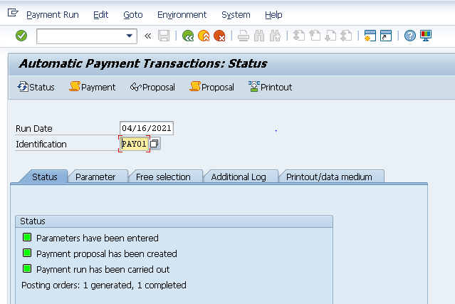
Initiating Automatic Payments Transaction
Transaction provides information on:
  What must be paid
  How it will be paid (paper check vs. ACH)
  Receiving bank accounts
Run Date and Identification are required to initiate the transaction

Slide 47
Demo 3.7: Initiate Automatic Payment Transaction
An invoice for Global Resources requires payment. Use the Automatic Payment Transaction to generate an ACH payment
Notes
  Transaction Code: F110
Notes:
Demonstration using:
Field: value
Field: value
Action
Other steps

Slide 48
Exercise 3.7: Initiate Automatic Payment Transaction
An invoice for Global Resources requires payment. Use the Automatic Payment Transaction to generate an ACH payment
Notes
  Transaction Code: F110
Notes:
Data Fields:
Field: value
Field: value

Slide 49
Non-Purchase Order Invoice
Non-PO invoices are the result of spend outside a regulated procurement process referred to as Expense Invoices
Non-PO invoices can also be the result of contracted products or services
PO purchasing is a business best practice but POs don’t make sense for smaller purchases, regular expenses, or legally contracted services
Invoice Receipt/ Verification
Release Payment
Reconciliation
Make Payment
Reporting

Slide 50
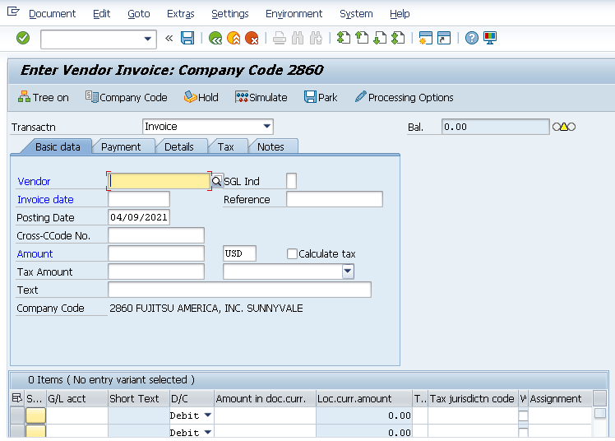
Entering a Non-PO Related Invoice
Transaction code FB60 used to enter an invoice not related to a purchase order
Required fields for entry include:
  Transaction
  Vendor
  Invoice Date
  Amount
  G/L Acct

Slide 51
Demo 3.8: Enter a Non-PO Invoice
An invoice for Global Resources is required for services rendered, so an invoice must be entered in the system
Notes
  Transaction Code: FB60
Notes:
Demonstration using:
Field: value
Field: value
Action
Other steps

Slide 52
Exercise 3.8: Enter a Non-PO Invoice
An invoice for Global Resources is required for services rendered, so an invoice must be entered in the system
Notes
  Transaction Code: FB60
Notes:
Data Fields:
Field: value
Field: value

Slide 53
Parking Invoices – REPLACE WITH BLOCKING
Utilized when you want to save the document but not officially post to the G/L
A parked invoiced can still be edited as required
Allows for final review and approval prior to posting
Invoice Receipt/ Verification
Release Payment
Reconciliation
Make Payment
Reporting

Slide 54
Demo 3.9: Park an Invoice
An invoice has been created but must be parked for review and approval prior to G/L posting
Notes
  Transaction Code: F-63
Notes:
Demonstration using:
Field: value
Field: value
Action
Other steps

Slide 55
Exercise 3.9: Park an Invoice
An invoice has been created but must be parked for review and approval prior to G/L posting
Notes
  Transaction Code: F-63
Notes:
Data Fields:
Field: value
Field: value

Slide 56
Unit 3, # 1
What does a parked invoice allow for?

Slide 57
Unit 3, # 1
What does a parked invoice allow for?
  Allows for final review and approval prior to posting

Slide 58
3
You should now be able to:
Enter a vendor invoice
Initiate an automatic payment transaction
Enter a non-purchase order invoice
Perform the steps needed to park a vendor invoice

Slide 59
Time for a Break!
Class starts again in 60 minutes

Slide 61
Agenda
Unit 1 – Introduction – Accounts Payable (20 mins)
Unit 2 – Enter/Park a Vendor Invoice (60 mins)
Unit 3 – Enter a Vendor Credit Memo (60 mins)
Unit 4 - Create a Vendor Account (30 mins)
Unit 5 – Summary (10 mins)

Slide 62
4
You should be able to:
Create a vendor account

Slide 63
Creating Vendor Master Data
Vendor Master Data contains information of a permanent nature, about a supplier/vendor that FAI does business with
FAI uses three vendor groups:
  Vendors
  One time vendor
  Employee Vendors
Contains data that determines how business transactions are recorded and processed
Invoice Receipt/ Verification
Release Payment
Reconciliation
Make Payment
Reporting

Slide 64
Vendor Master Process Flow
Vendor Master
Procure Team
3PDD Required?
Required forms forwarded/obtained from Vendor for Acct set-up
Create Vendor Master
FK01
Forms attached; email forwarded to AP to set up Accounting section
NO
Yes
Procure Global
3PDD questionnaire forwarded to Vendor to complete
3PDD conf # obtained /if not required move to next step
AP Team
Non-PO accounts to be set up by AP - (tax agencies, etc)
Complete
Finance Section on Master
FK01
Complete bank & tax sections; mailing codes if required
Account ready to issue PO /enter invoices & issue payments
End

Slide 65
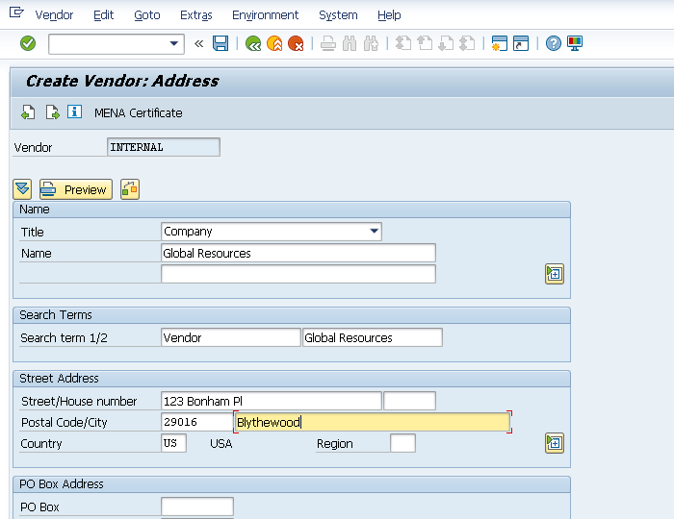
Vendor Master – General Information
FK01 is used to create a new vendor account
Some general information needed to create the account includes:
  Name
  Search Terms
  Street Address

Slide 66
Demo 4.10: Create a Vendor Account
FAI is scheduled to procure services and goods from Global Resources. Prior to conducting business, they must have a vendor account available in the system
Notes
  Transaction Code: FK01
Notes:
Demonstration using:
Field: value
Field: value
Action
Other steps

Slide 67
Exercise 4.10: Create a Vendor Account
FAI is scheduled to procure services and goods from Global Resources. Prior to conducting business, they must have a vendor account available in the system
Create a Vendor Account
Notes
  Transaction Code: FK01
Notes:
Data Fields:
Field: value
Field: value

Slide 68
Unit 4, # 1
FAI uses what three vendor groups?

Slide 69
Unit 4, # 1
FAI uses what three vendor groups?
  FAI uses three vendor groups:
    Vendors
    One time vendor
    Employee Vendors

Slide 70
4
You should now be able to:
Create a vendor account

Slide 72
Agenda
Unit 1 – Introduction – Accounts Payable (20 mins)
Unit 2 – Enter/Park a Vendor Invoice (60 mins)
Unit 3 – Enter a Vendor Credit Memo (60 mins)
Unit 4 - Create a Vendor Account (30 mins)
Unit 5 – Summary (10 mins)

Slide 73
Course Key Points
  Vital for FAI because:
    It takes charge of paying bills on a timely basis
    Vendors ensure an uninterrupted flow of supplies and services due to on-time payments
    It ensures there are no overdue charges, penalties, or late fees
    It ensures all invoices due are tracked and paid properly
  AP’s role is to complete payments and control expenses by receiving payments, plus processing, verifying and reconciling invoices
  Non-PO invoices are the result of spend outside a regulated procurement process referred to as Expense Invoices

Slide 74
Course Key Points (Cont.)
  A parked invoiced can still be edited as required
  Credit memos can be applied to a vendor’s account as a payment or reduction in cost
  After a credit memo is posted to a customer’s account, it must be cleared

Slide 75
Course Summary
You should now be able to:
Describe the accounts payable process
Create a vendor account
Enter/park a vendor invoice
Enter a vendor credit memo
Initiate the automatic clearing process

Slide 76

Next Steps
Practice: Prior to go live, be sure to practice the transactions exercised today using the following resources available:
  Training Environment and Training ID (TBD)
  uPerform recordings located in the LMS (TBD)
If you have questions...
  Help Desk (TBD)
  LMS/SharePoint site for reference materials (TBD)
  Other Users
  Super Users

Slide 77

Before You Leave…
Last chance for Q & A!
Please be sure to complete the Class evaluation in order to help us improve on future classes!
57

Slide 78

Congratulations!
You have completed this course!

